Slide 1
CS5551 Advanced Software Engineering
Mobile Apps
Source: Mobile Development: HTML5 Vs Native By Rohit Ghatol

Slide 2
Types of Mobile Apps
Mobile Web App
Native App
Hybrid (Web + Native) App

Slide 3
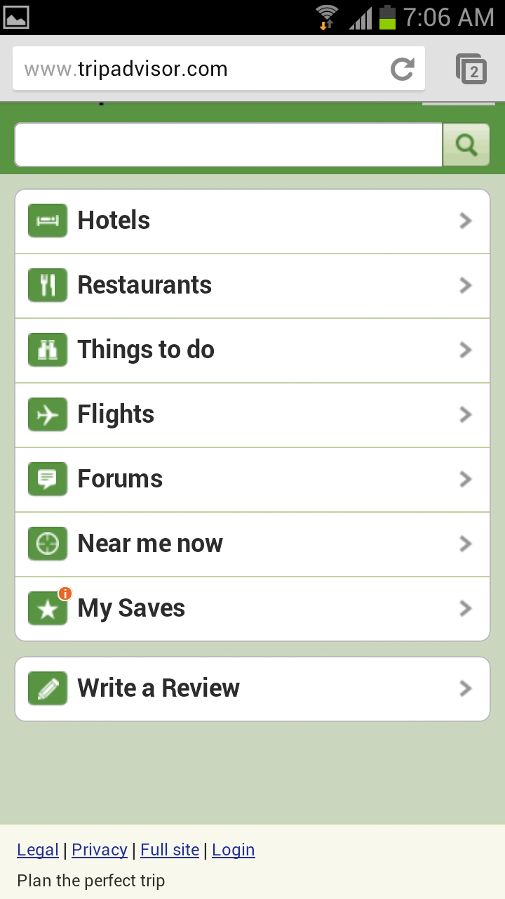
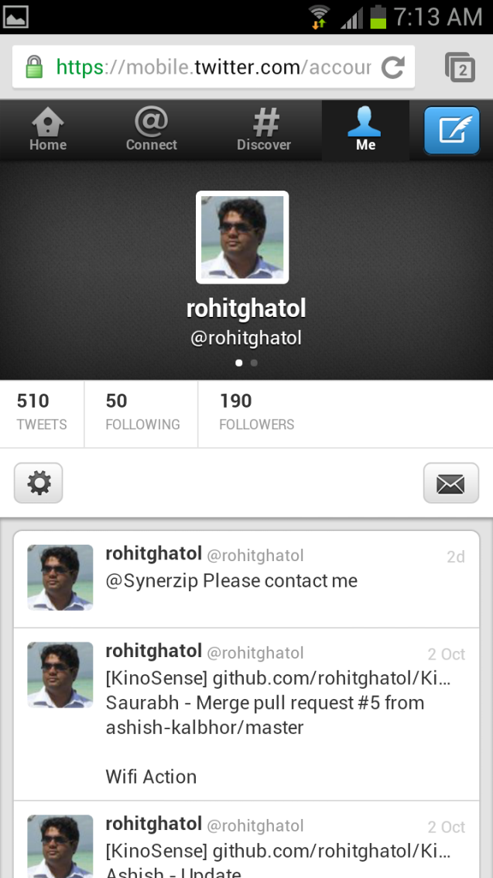
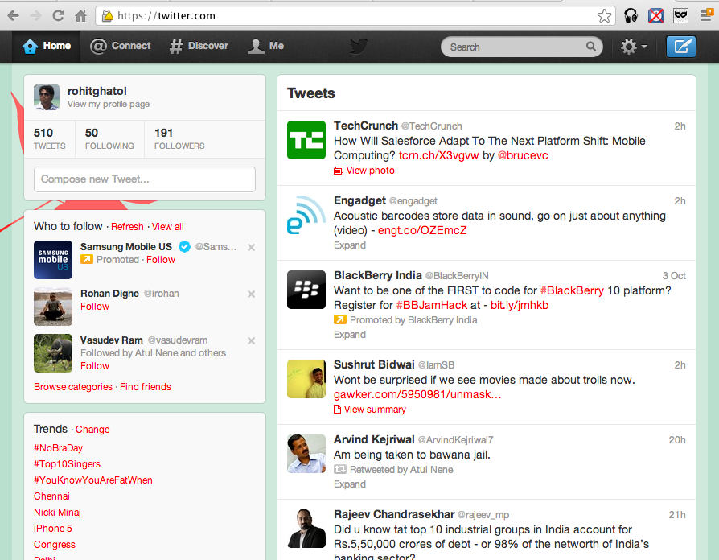
Web Mobile App
c
9

Slide 4
Web App Overview
Web Apps run inside a Browser and cannot make use of many things that Mobile OS provides, like File System, SQLLite Database, Network APIs, Camera, Contacts etc.
A few APIs are exposed to browser JavaScripts like GeoLocation, very limited local storage, and more.
Browser App
http://m.twitter.com
Mobile OS
File System
SQL-Lite
Network
Camera
GeoLocation
Contacts
Accelerometer
Native APIs
.....
.....

Slide 5
Web App Capabilities
Browser App
http://m.twitter.com
Some Web App new features include:
GeoLocation
Audio/Video Tag
Canvas/SVG
Local Storage
Web Workers
Web Sockets
Mobile OS
File System
SQL-Lite
Network
Camera
GeoLocation
Contacts
Accelerometer
Native APIs
.....
.....
SVG Scalable Vector Graphics is used to define graphics for the Web
HTML5 Web Workers. A web worker is a JavaScript running in the background, without affecting the performance of the page. The WebSocket specification defines an API establishing "socket" connections between a web browser and a server.

Slide 6
Web App Cons
User needs to open browser
Loading time is slowest
No notification available for updates
Limited access to Phone Features
App Store Marketing not available
HTML5 Fragmentation
Simulation of Native UX (user experience)
19

Slide 7
Web App Pros
Lowest Development Cost
Maximum Reuse
No App Store Distribution hassles
Instant Updates, Clients on latest Version

Slide 8
Web App Limitations
Browser App
http://m.twitter.com
A Web App runs as long as a browser is running. Web Apps start only when a user starts them; no native-like background processing is available.
Mobile OS
File System
SQL-Lite
Network
Camera
GeoLocation
Contacts
Accelerometer
Native APIs
.....
.....

Slide 9
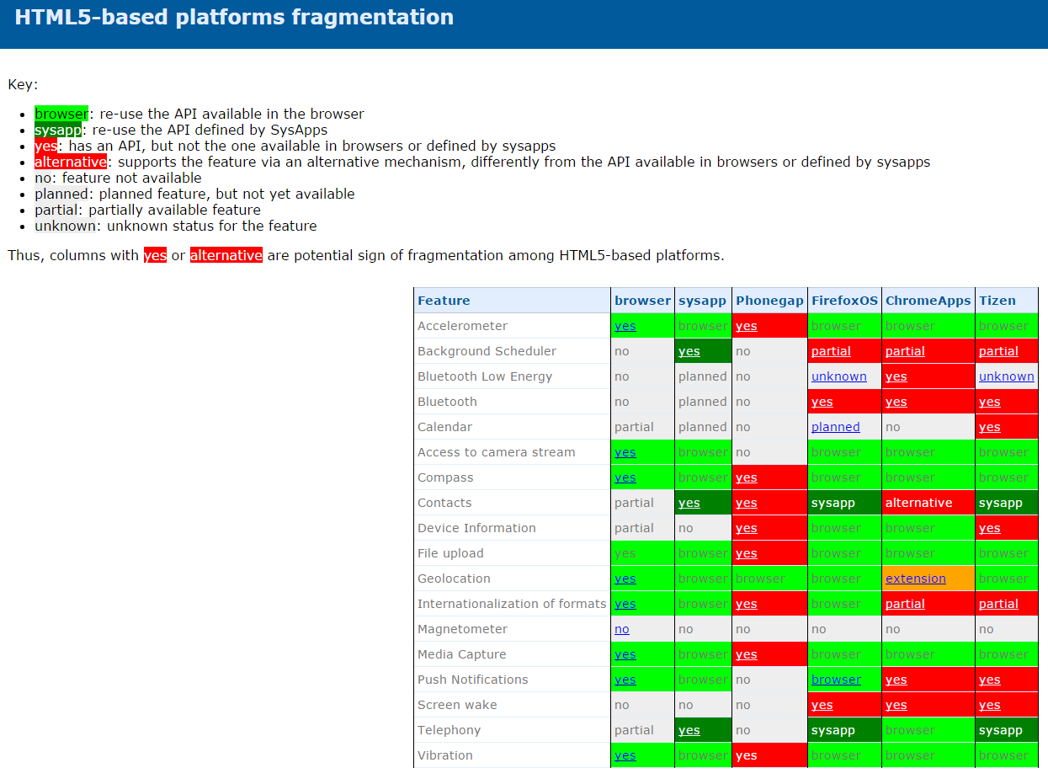
http://lists.w3.org/Archives/Public/public-web-mobile/2014May/att-0023/html5-fragmentation.html

Slide 10
Native App Overview
20

Slide 11

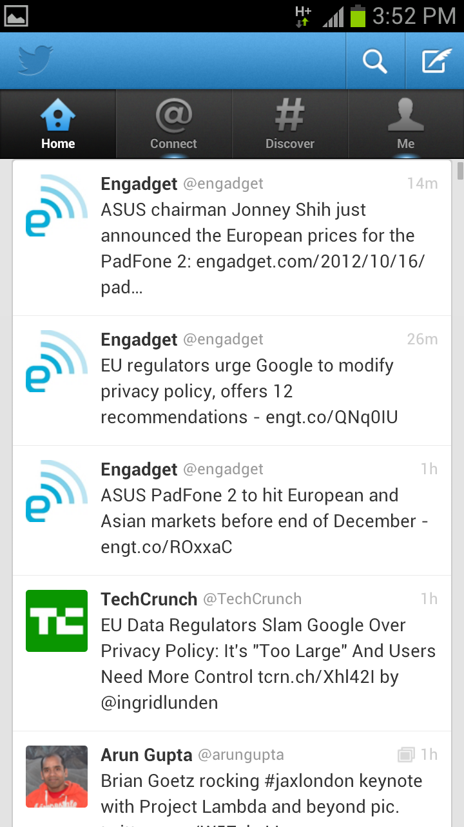
Native App
21

Slide 12
Native App Overview
Twitter App
Full Access
Mobile OS
File System
SQL-Lite
Network
Camera
GeoLocation
Contacts
Accelerometer
Native APIs
.....
.....
22

Slide 13
Native App Pros
Prowess of Mobile is available
Ability to build Richest & Fastest Apps
Notifications Available
Offline Storage Available
Background Processing Available
Entire Device Sensor Array Available
App Store/Market Monetization Possible
24

Slide 14
Native App Cons
Highest Development Cost
Dedicated teams for different Platforms
Architecture Reuse Possible
Design/Code Reuse not Possible
AppStore/Market approval is prerequisite for launch of new features
Fragmentation is also an issue (devices/OS/version)
26

Slide 15
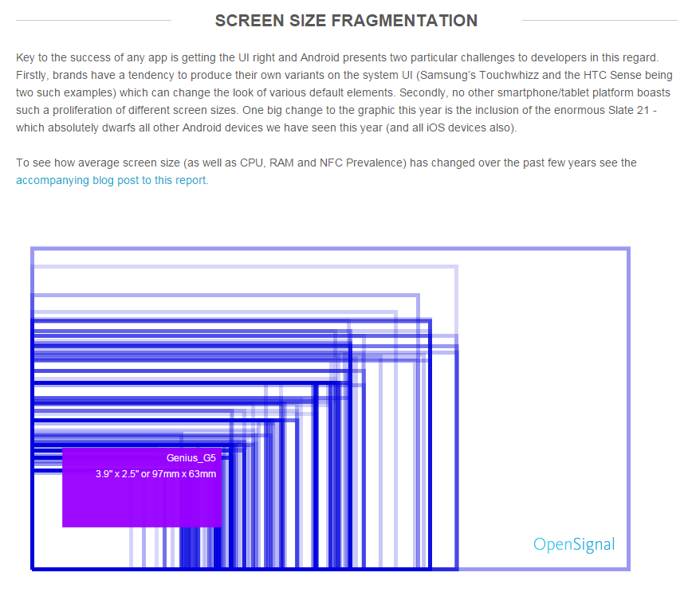
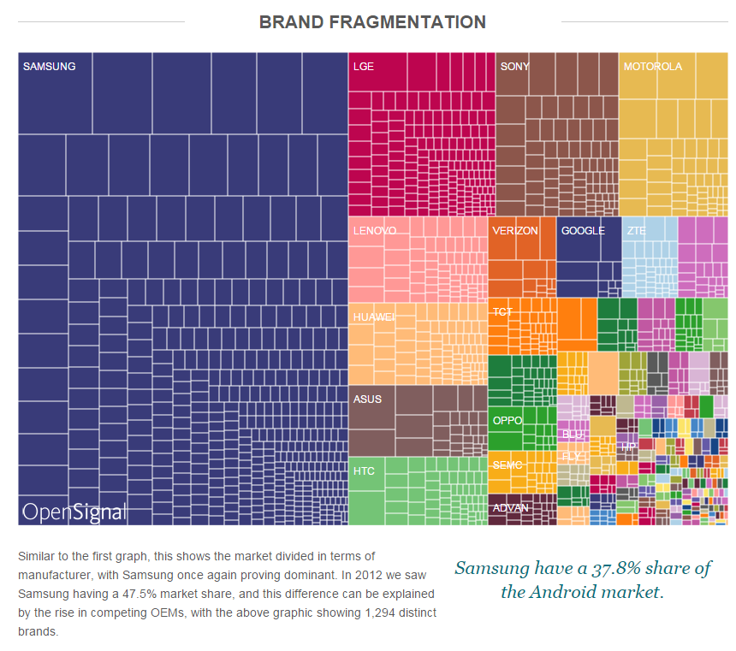
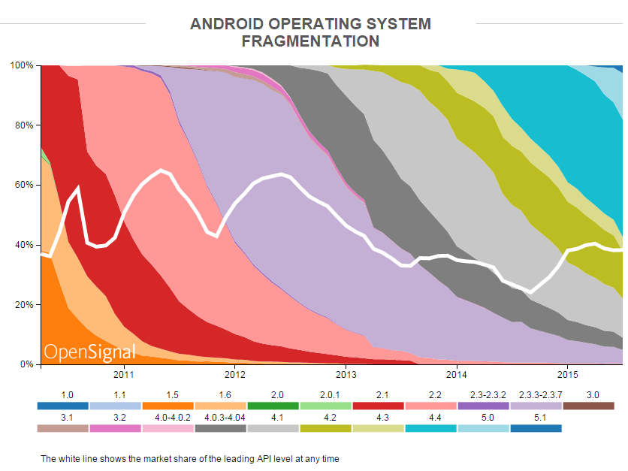
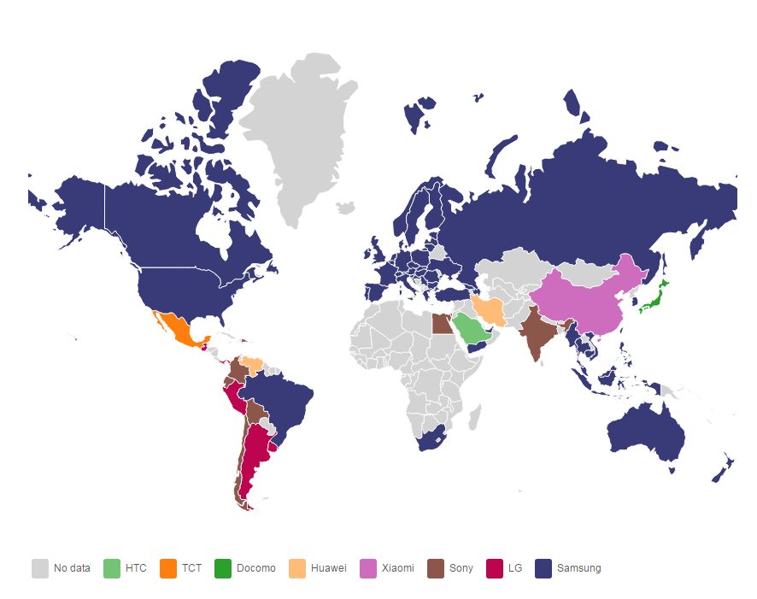
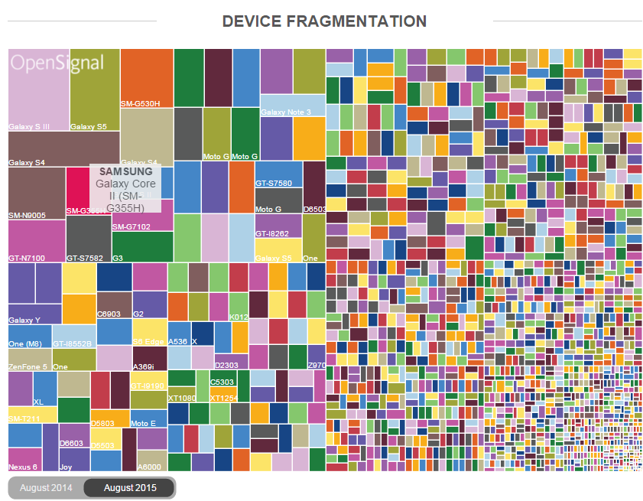
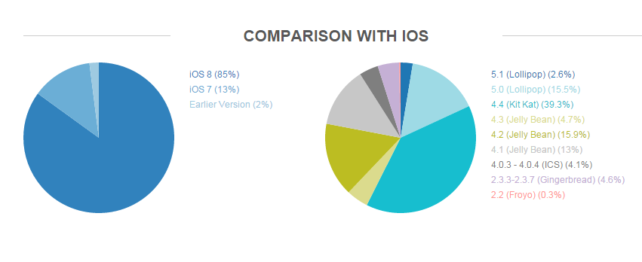
http://thenextweb.com/insider/2015/08/05/this-is-what-android-fragmentation-looks-like-in-2015/#gref

Slide 16
Hybrid Apps Overview
Web + Native
28

Slide 17
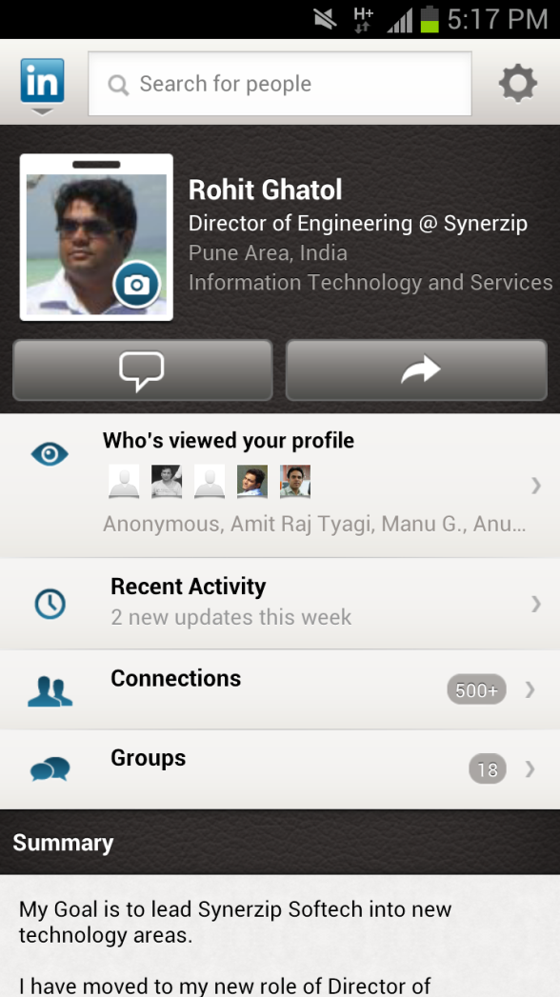
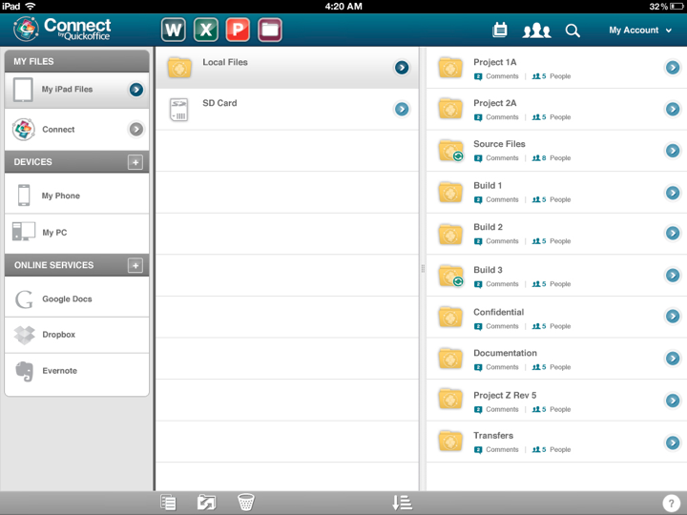
Hybrid Mobile App
27

Slide 18
Hybrid App Overview (1)
Twitter App
Embedded Browser
Hybrid Apps are
Native Apps
file://index.html
Full Access
Mobile OS
File System
SQL-Lite
Network
Camera
GeoLocation
Contacts
Accelerometer
Native APIs
.....
.....
29

Slide 19
Hybrid App Overview (2)
Twitter App
Embedded Browser
file://index.html
Web App is hosted inside Native App
Full Access
Mobile OS
File System
SQL-Lite
Network
Camera
GeoLocation
Contacts
Accelerometer
Native APIs
.....
.....
30

Slide 20
Hybrid App Overview (3)
Twitter App
Embedded Browser
file://index.html
Web App's JavaScript can communicate to Native and back
Full Access
Mobile OS
File System
SQL-Lite
Network
Camera
GeoLocation
Contacts
Accelerometer
Native APIs
.....
.....
31

Slide 21
Hybrid App Overview (4)
Twitter App
Embedded Browser
file://index.html
HTML5 contains BI, Native Component are built as Lego blocks
Business Intelligence
Full Access
Custom Components
Mobile OS
File System
SQL-Lite
Network
Camera
GeoLocation
Contacts
Accelerometer
Native APIs
.....
.....
32

Slide 22
Hybrid App Pros
Best of Both Worlds
Native App with Embedded Browser
HTML5 in Embedded Browser
Business Logic in HTML 5/Server
Sensor Array available via Native
Any Extensions are Native

Slide 23
Hybrid App Cons
Development Environment is Complex
Eclipse, XCode, Visual Studio, Brackets
CIT (Computer Integration Technologies)Builds and Release cycles
Native Skills required for extensions across platforms
Pains from both worlds─ Catching up on new OS and HTML5 Feature sets

Slide 24
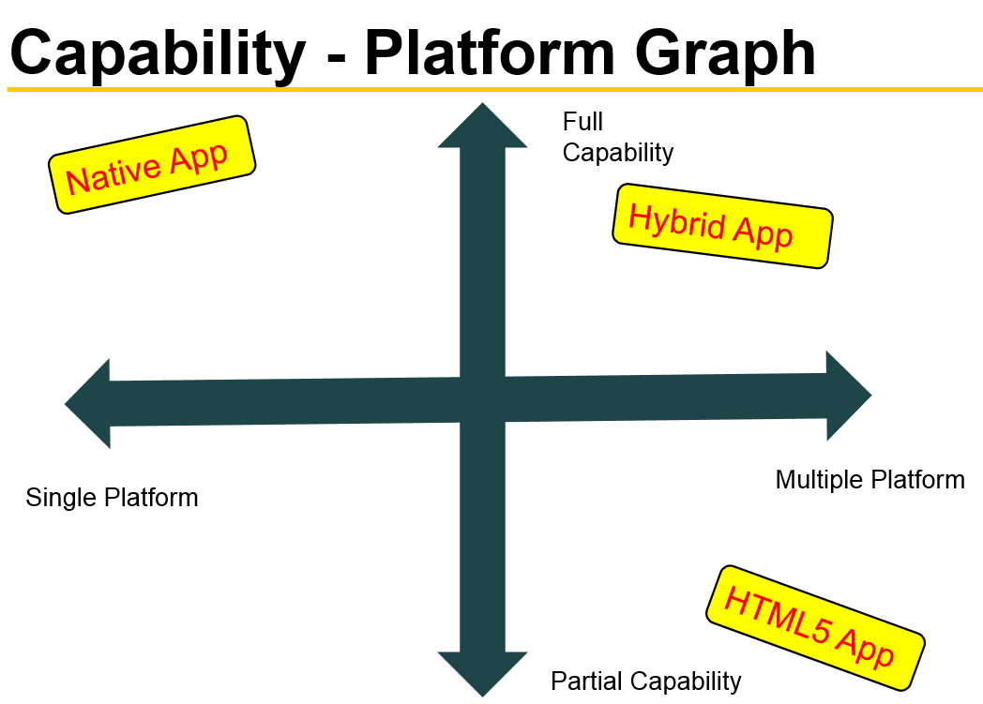
Web

Slide 25
When to choose which route?
Rich User Experience
Performance
Development Cost
Time to Market
App Store Distribution
Security
49

Slide 26
Factors for Choosing
 | Native | Hybrid | Web
Performance | Highest | High | Low
Rich UI | Highest | Moderate | Moderate
Development Cost | Highest | High | Lower
Time to Market | Longest | Moderate | Shortest
App Store Engagement | Maximum Engagement | Maximum Engagement | No Engagement
Security | Highest | High | Limited
50

